Slide 1
Maximum Likelihood Estimation
Presented by Maureen Palmer

Slide 2


Definition
Likelihood = basically p({data}|Model)
Not a true pdf because it’s not normalized
$L≡\prod_{i=0}^{n}{p\left(x_{i} | M\left(θ\right)\right)}$
Pdf of 1 data point
(Normalized)
Number of data points
= Product of likelihoods of all data points
Model parameters
Data point
value
Model value
Can be <<1 for large datasets

Slide 3
The Maximum Likelihood Estimation Method
Describe a model with variable parameters
e.g. Spectral lines which vary in intensity depending on temperature and abundances
Search for the model parameters that maximize the likelihood (i.e. p(data|model) )
Determine confidence intervals for model parameters (sections 4.2.5 and 4.5)
Perform hypothesis testing (section 4.6)

Slide 4


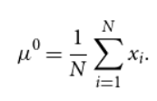
Example 1: Finding the most likely length
Data: Measurements of the length of a rod, with error σ
Step 1: Decide on a model
Model length = μ
Step 2: Search for best-fit parameters
Calculate likelihood:
Take the natural log (for ease of calculations):
Find the value that maximizes ln(L), i.e. find where dln(L)/dμ=0
Superscript 0
= most likely value
for that parameter
(as expected)

Slide 5
How to handle some problems
No detection = Want to calculate an upper limit
“Censored data”
Discussed in section 8.1
Truncated data
e.g. What is the average period of exoplanets based on 4 years of Kepler observations?

Slide 6
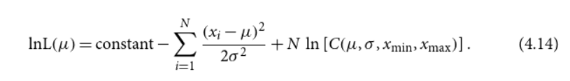
Example 2: Truncated data calculations
To find the most likely mean value, calculate the maximum of this equation:
N = number of data points
x_{i} = data value
μ = mean (model) value
σ = observed standard deviation error
x_{min} , x_{max} = lower/upper bounds
Renormalization constant

Slide 7

χ²
What it is:
When to use:
Minimize this value to identify the model parameters that best fit your data
When NOT to use:
Data with lots of outliers (Remove them first, or else χ² will be abnormally large)
If model likelihoods are non-Gaussian, you can use χ² to compare two models, BUT you cannot use it to calculate the actual chances of the models producing the observed data
N = number of data points
k = number of model parameters
N – k = degrees of freedom
z_{i} = (data – model)/error

Slide 8
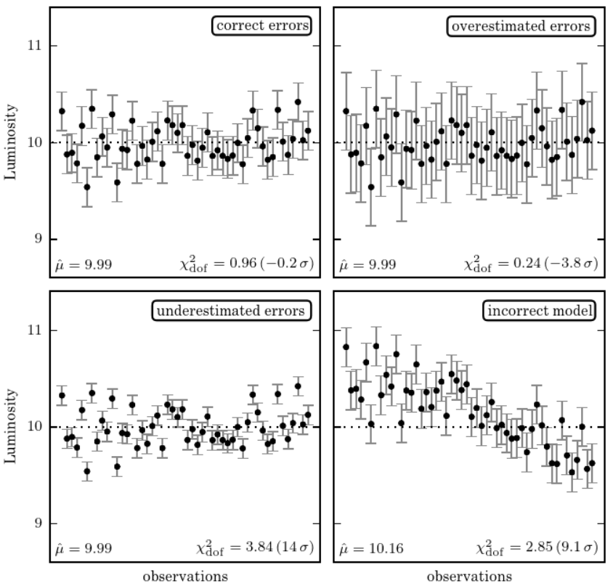
Textbook figure 4.1

Slide 9
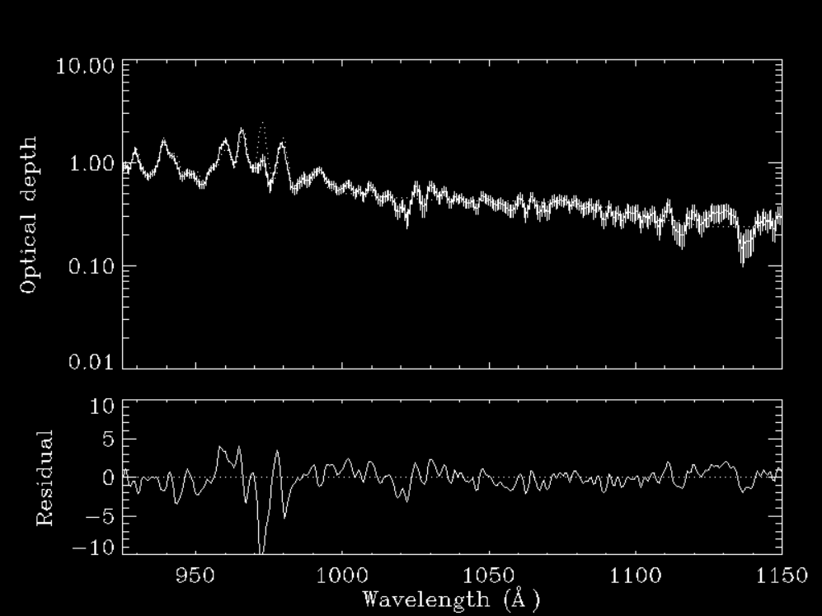


Slide 10

Are we over-fitting the data? (Bayesian approach has another criteria)
Akaike Information Criterion (AIC)
Number of model parameters
$$AIC≡−2\ln\left(L^{0}\left(M\right)\right)+2k+\frac{2k(k+1)}{N−k−1}$$
=χ²
Number of data points
Smaller AIC = Better model (Occam’s razor)

Slide 11
Codes you might want to use sometime
If your likelihood is a mixture of multiple Gaussians: (approximate any distribution by multiple Gaussians)
see code in section 4.4.3
Calculate confidence intervals for distributions that are non-Gaussian and/or small
Bootstrap and jackknife methods: see code in section 4.5

